Slide 1
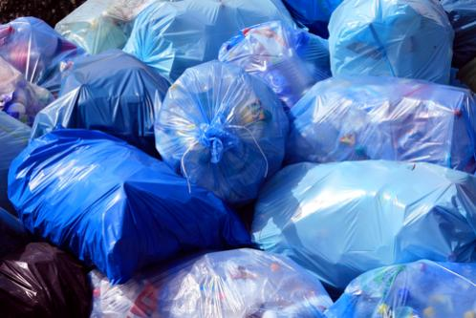
7-1 THE FORM OF MODAL AUXILIARIES
Somebody should clean up this mess.

Slide 2
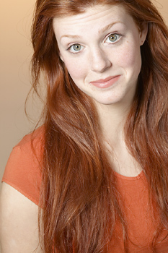
13-1 USING SHOULD
My hair is very long.
I should cut it.

Slide 3
13-1 USING SHOULD
(a) My hair is very long.
I should cut it.
(b) Allen is hungry.
He should eat lunch.
(c) You are tired.
You should go home.
should = This is a good idea.
(advice)

Slide 4
13-1 USING SHOULD
(d)
I
You
She
He
It
We
They
should go.
should + simple form of verb

Slide 5
13-1 USING SHOULD
(d) He should go.
?
He should goes.
?
He should to go.
should + simple form of verb

Slide 6
13-1 USING SHOULD
(e) You should not go out in the rain.
You will get wet.
(f) You shouldn’t go out in the rain.
NEGATIVE: should not
CONTRACTION: should + not = shouldn’t

Slide 7
7-7 EXPRESSING ADVICE: SHOULD AND OUGHT TO
(d) You need to study. You should not go out.
You need to study. You shouldn’t go out.
NEGATIVE: should + not = shouldn’t
Ought to not usually used in negative

Slide 8

7-7 EXPRESSING ADVICE: SHOULD AND OUGHT TO
I don’t understand the assignment. What should I do?
(e)
QUESTION: should + subject + main verb
Ought to not usually used in questions

Slide 9
13-1 Let’s Practice
wash them
try harder
call your mother
learn to drive
go to the library
stop smoking
I need information for my homework.
You should ______________.

Slide 10
13-1 Let’s Practice
wash them
try harder
call your mother
learn to drive
go to the library
stop smoking
Your clothes are dirty.
You should ___________.

Slide 11
13-1 Let’s Practice
wash them
try harder
call your mother
learn to drive
go to the library
stop smoking
Smoking is not healthy.
You should _____________.

Slide 12
7-1 THE FORM OF MODAL AUXILIARIES
AUXILIARY + SIMPLE FORM OF VERB
could
must
can
would
should
may
will
might
had better
not followed by to
Inga can to play the violin.

Slide 13
7-1 THE FORM OF MODAL AUXILIARIES
AUXILIARY + SIMPLE FORM OF VERB
could
must
can
would
should
may
will
might
had better
no final -s
Inga can plays the violin.

Slide 14
7-1 THE FORM OF MODAL AUXILIARIES
AUXILIARY + SIMPLE FORM OF VERB
could
must
can
would
should
may
will
might
had better
not in past form
Inga can played the violin.

Slide 15
7-1 THE FORM OF MODAL AUXILIARIES
AUXILIARY + SIMPLE FORM OF VERB
could
must
can
would
should
may
will
might
had better
not in -ing form
Inga can playing the violin.

Slide 16
7-1 THE FORM OF MODAL AUXILIARIES
AUXILIARY + TO + SIMPLE FORM OF VERB
have got to (k) He has got to be on time.
ought to (l) It ought to be fun.
to + simple form

Slide 17
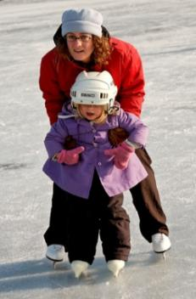
7-1 LET’S PRACTICE
to
Ø
She ought ___ learn how to skate.
to

Slide 18
7-1 LET’S PRACTICE
to
Ø
She should ___ learn how to skate.
Ø

Slide 19

7-4 LET’S PRACTICE
I’d like to visit a beautiful place.
We could go to Thailand.
?

Slide 20
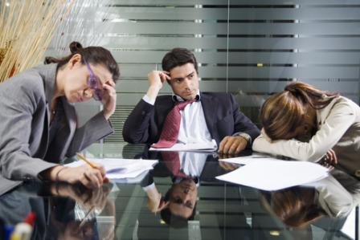
7-7 EXPRESSING ADVICE: SHOULD AND OUGHT TO
They should go home
and get some rest.

Slide 21

7-7 EXPRESSING ADVICE: SHOULD AND OUGHT TO
You should come in to see me.
(f)

Slide 22
7-7 EXPRESSING ADVICE: SHOULD AND OUGHT TO
You ought to come in to see me.
(f)

Slide 23
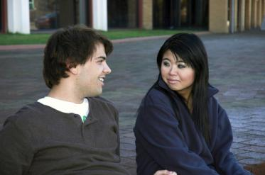
7-7 LET’S PRACTICE
should
I need a book about geology.
You should go
to the library.

Slide 24
7-7 LET’S PRACTICE
ought to
I need a book about geology.
You ought to go
to the library.

Slide 25
7-7 LET’S PRACTICE
maybe, should
I need a book about geology.
Maybe you should go
to the library.

Slide 26
7-8 EXPRESSING ADVICE: HAD BETTER
They had better go home
and get some rest.

Slide 27
7-8 EXPRESSING ADVICE: HAD BETTER
should
ought to
had better
(a) I have a headache. I take a nap.
should
ought to
had better
same
meaning
good idea, good advice

Slide 28
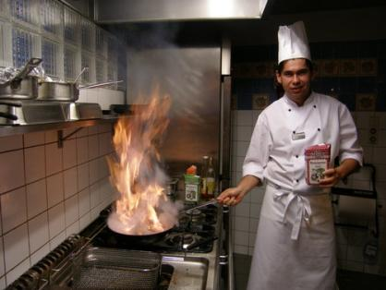
7-8 EXPRESSING ADVICE: HAD BETTER
(b) He’d better be careful. His pan is on fire!
Had better usually = warning

Slide 29
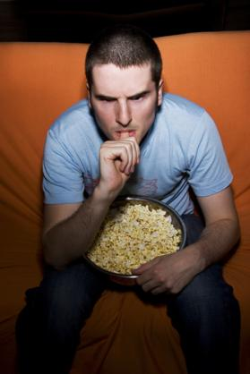
7-8 LET’S PRACTICE
You’d better quit watching
TV all day.
Possible bad results?
✓
eat too much
catch a cold
hurt your eyes
not study enough
not exercise enough
✓
✓
✓

Slide 30
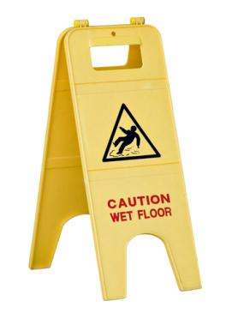
7-8 LET’S PRACTICE
He’d better not walk there.
Possible bad results?
✓
fall
get hurt
get the flu
be embarrassed
fail a test
✓
✓

Slide 31
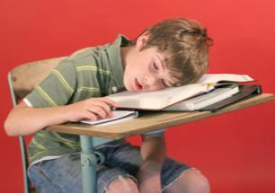
7-8 LET’S PRACTICE
He’d better stay awake in school.
Possible bad results?
✓
miss something
get hurt
get in trouble
fail a test
get the flu
✓
✓

